Slide 1
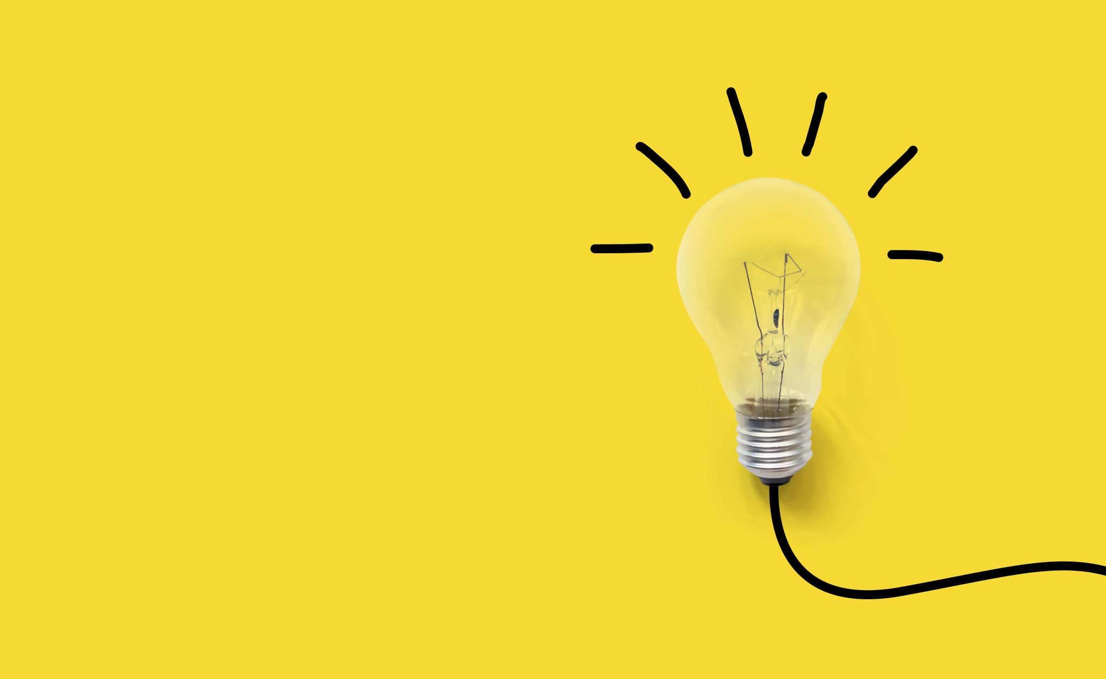
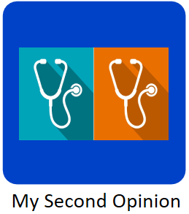
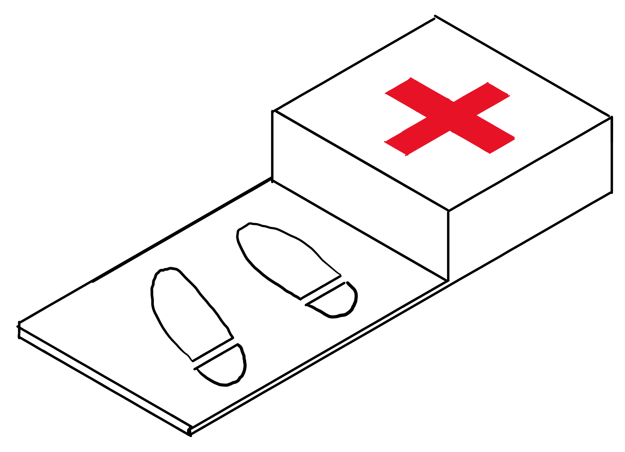
Big Design EWB 2020
Thomas Lando
My Tele Health Kit

Slide 2


My Second Opinion
An application to connect us and the health industry together like never before

Slide 3
What is the App for?
It provides both patients and Health workers to provide and receive second opinions/ advice on different cases from anywhere in the country.
It will make it easier to refer patients to other specialists such as physios and dieticians as well as indigenous councillors and specialist doctors.
It will also allow for rural or remote doctors to ask for advice from accredited opinions in the industry on how to provide treatment to a person far from the city.

Slide 4
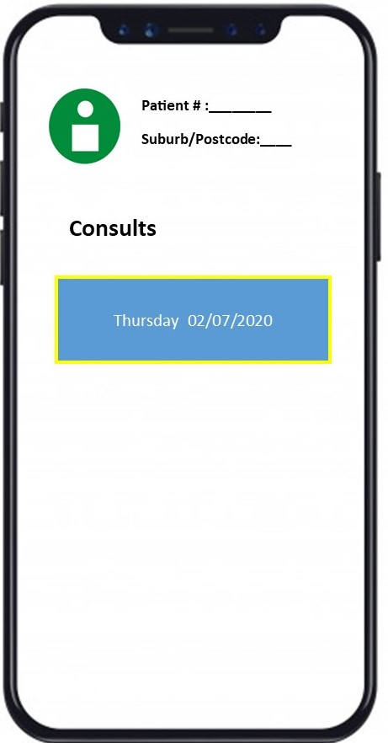
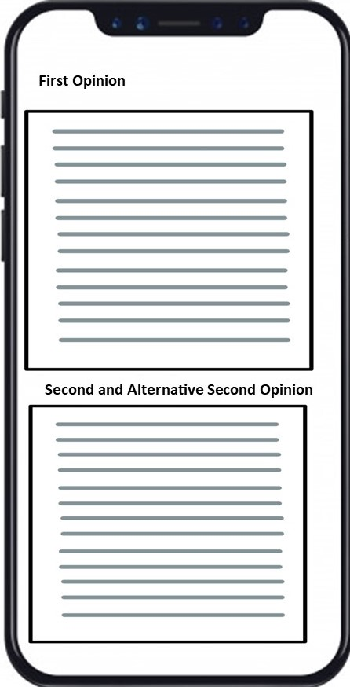

Slide 5
My Tele-Health

Slide 6
The Idea
A standard set of clinical equipment allow the doctor to conduct general checks without needing to be present
This is designed to link to the My Second Opinion App as well as its own software to “shorten the distance” between the patient and the doctor.
Allows the patient to measure their weight, blood pressure, blood sugar, heart rate, temperature and height.

Slide 7
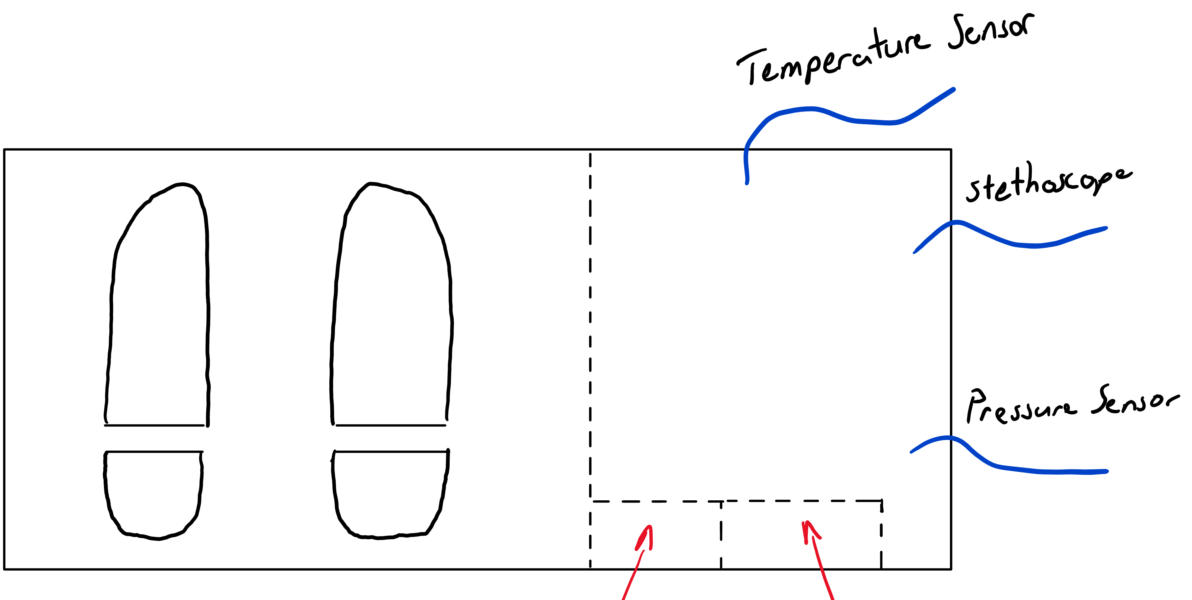

Slide 8
But Wait… How?

Slide 9

Through the use of Strain Gauges, Resistance Temperature Detectors and Resistive Displacement Transducers the analogue measurements can be taken.
Through the use of Analogue to Digital Converters (ADC), the measurements can be transferred and read by the software.
The doctor on the other side of the camera can then perform a regular consultation as if they were in the room with the patient.

Slide 10
So let’s get down to it

Slide 11

Cost
The App
To build this app from scratch the cost in terms of money would be enormous.
Australia however would not have to start from nothing.
The Device
The exterior of the My Tele-Health device could be made from either recycled metal or plastic.
The instruments themselves are also very cheap and readily available.
Thus, the cost of the materials would not necessarily be too expensive, likely $1000 to $3000 dollars for the whole device.

Slide 12
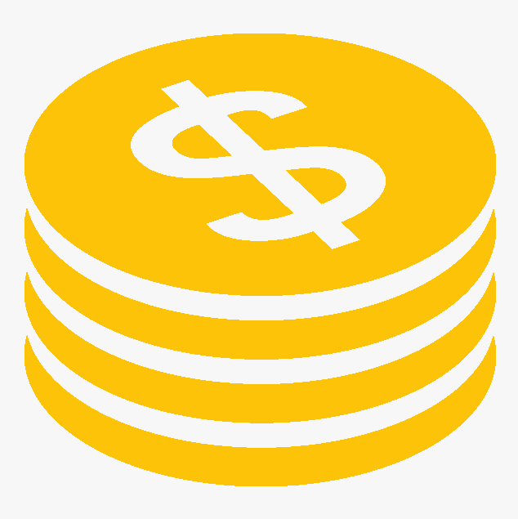
Let’s pitch this to Rural/ Remote Australia, as of 2017;
7 million people live in rural or remote Australia.
20% of this population do not have access to a nearby GP
60% do not have access to a specialist nearby
The cost to develop an app from scratch is $5 million
If this was taxpayer funded by the Rural population alone, it would cost around $0.72 per person.
If this app costs $1 million to maintain
This would cost $0.15 per person, per year.
Notes:
72 cents to develop
15 cents to maintain

Slide 13
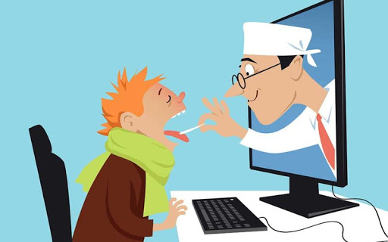
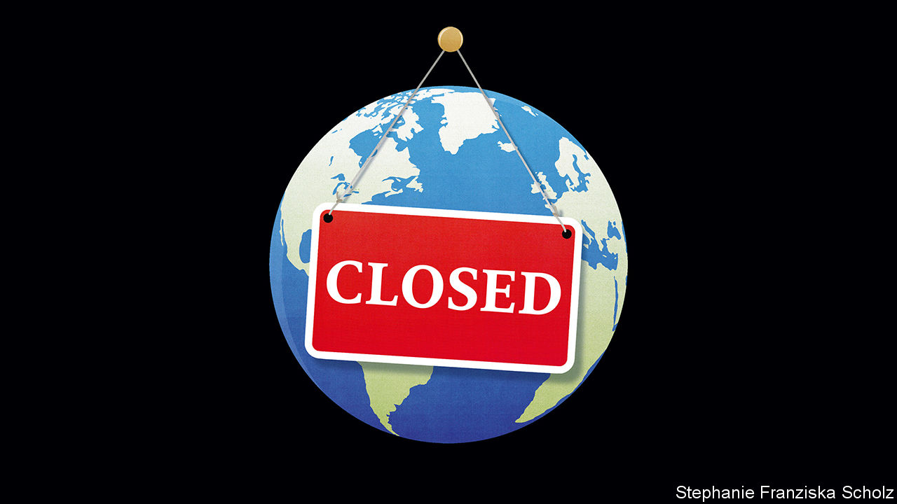
Design Brief

Slide 14

Sustainability

Slide 15

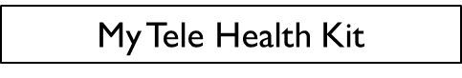
Overall

